Slide 1
RESUME CLASSIFICATION
GROUP 2

Slide 2
Team Members:
Ponaganti Vinay Kumar
Bandru Vinay Sai
K. Sampath Kumar Reddy
Snimy Stephen
Arif Ur Rehman
Astik Alamprabhu Watambe

Slide 3
BUSINESS OBJECTIVE
The objective here is to , classify the Resumes in such a way that, it minimizes the manual efforts in the HRM.
Also, there should be higher level of accuracy and automation, with minimal human efforts.
Sample dataset used:
Resumes

Slide 4
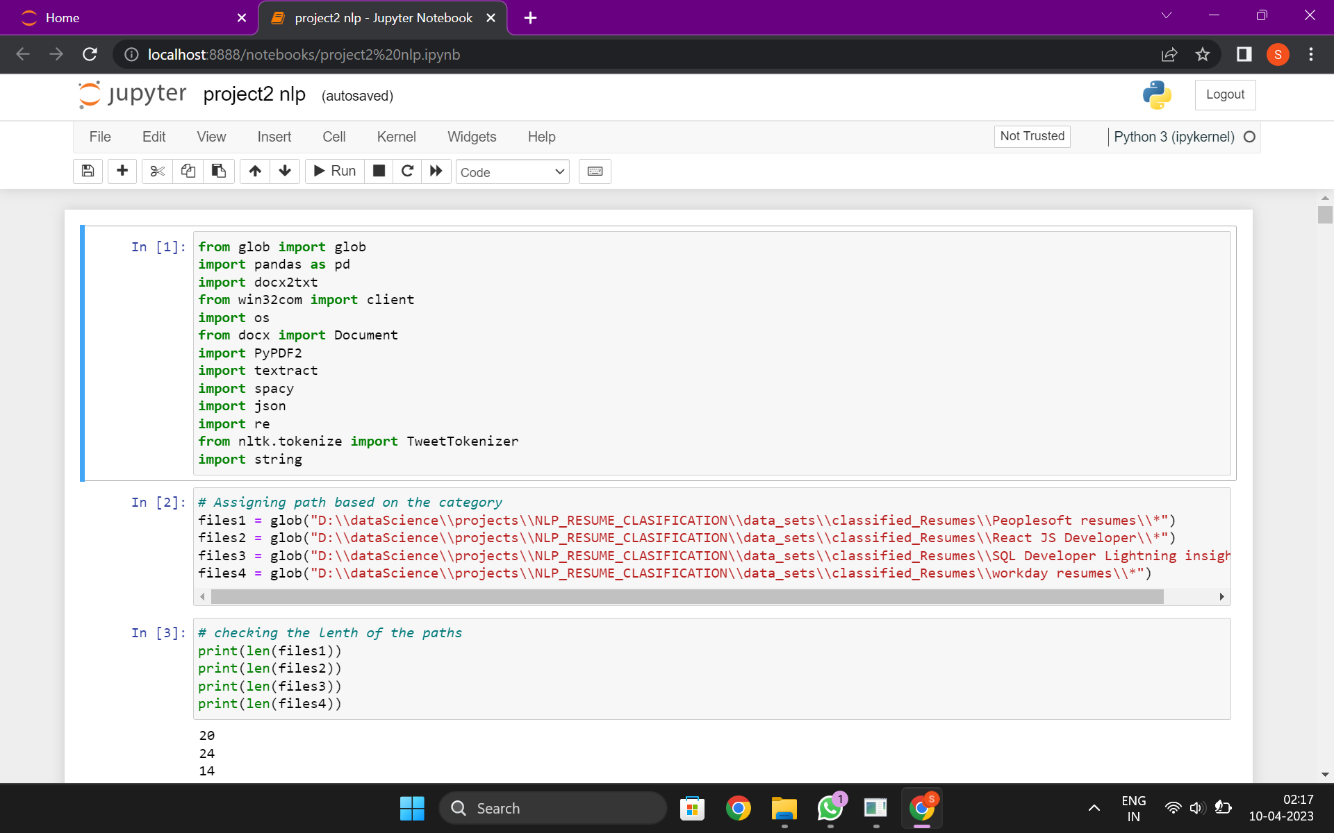
DATA EXTRACTION
The necessary libraries are imported and each category is loaded into different files for easy differentiation.

Slide 5
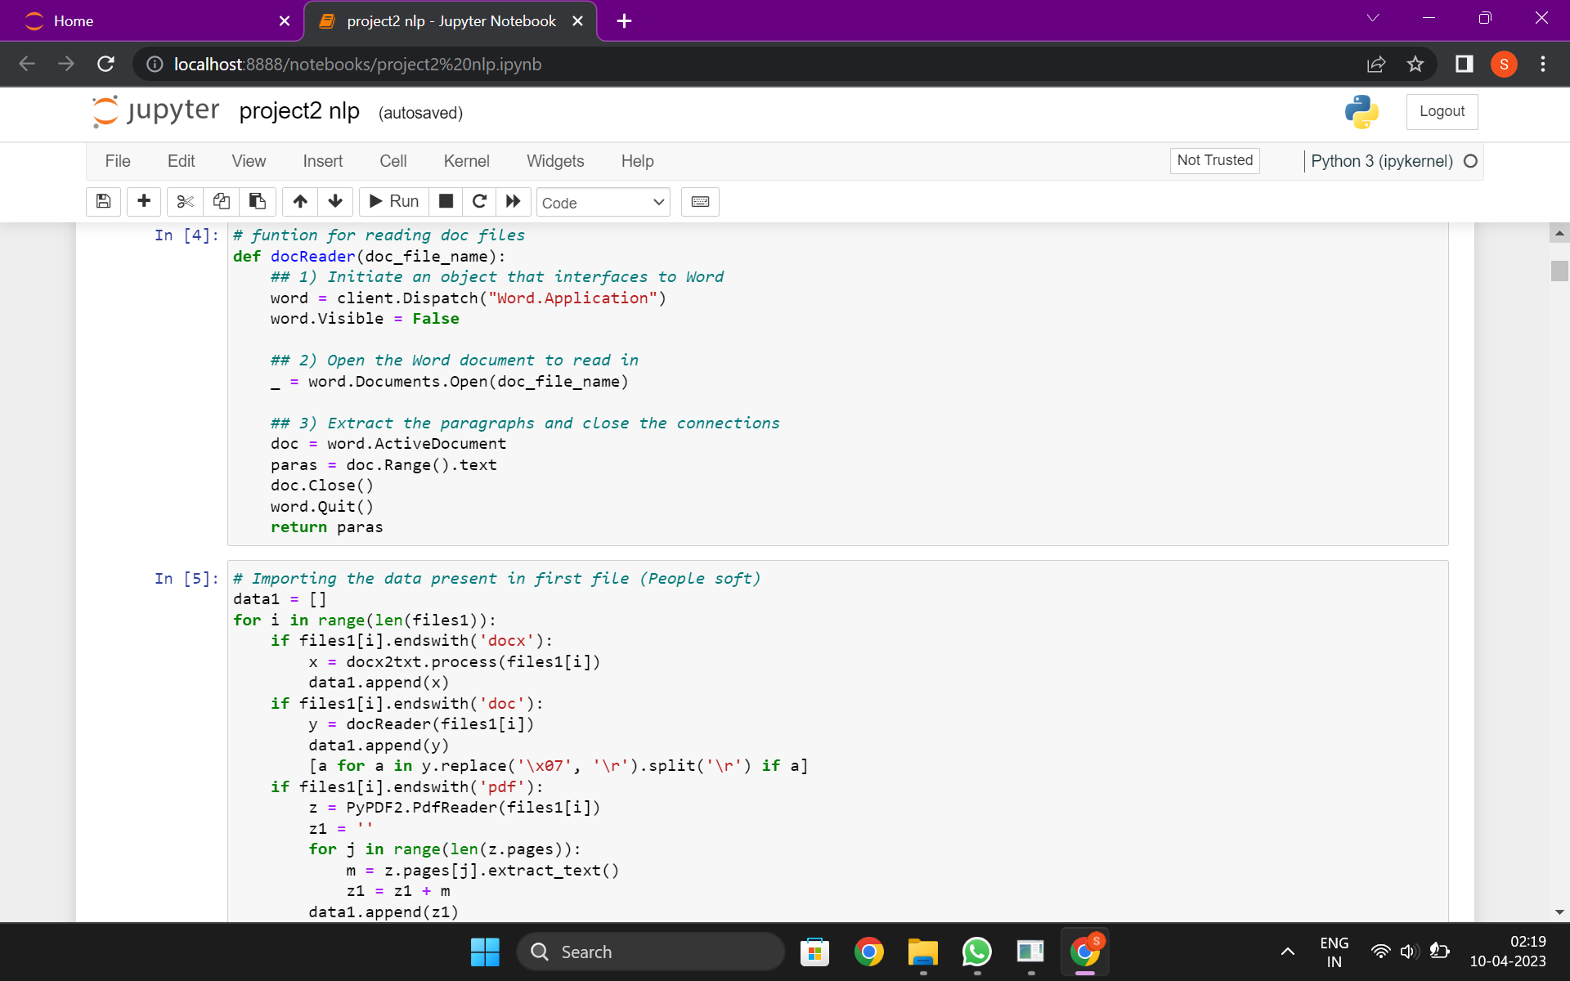
To read the files , the function docreader is used and then the paragraphs are being extracted.
Data is imported from each file created for each category and then put into a data frame.

Slide 6
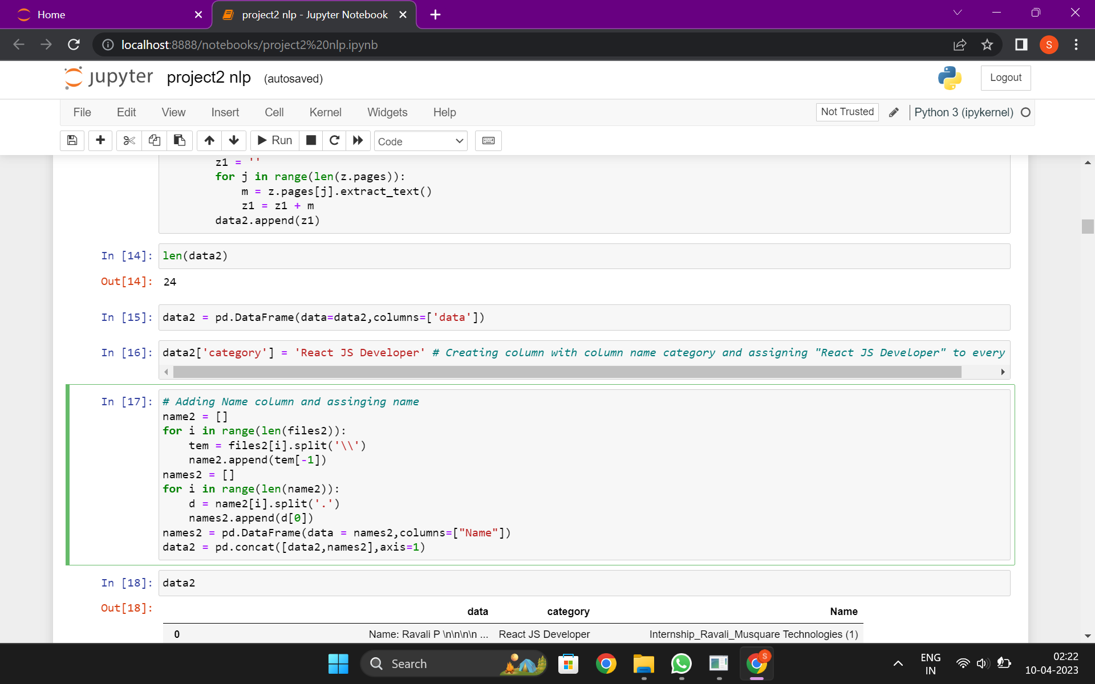
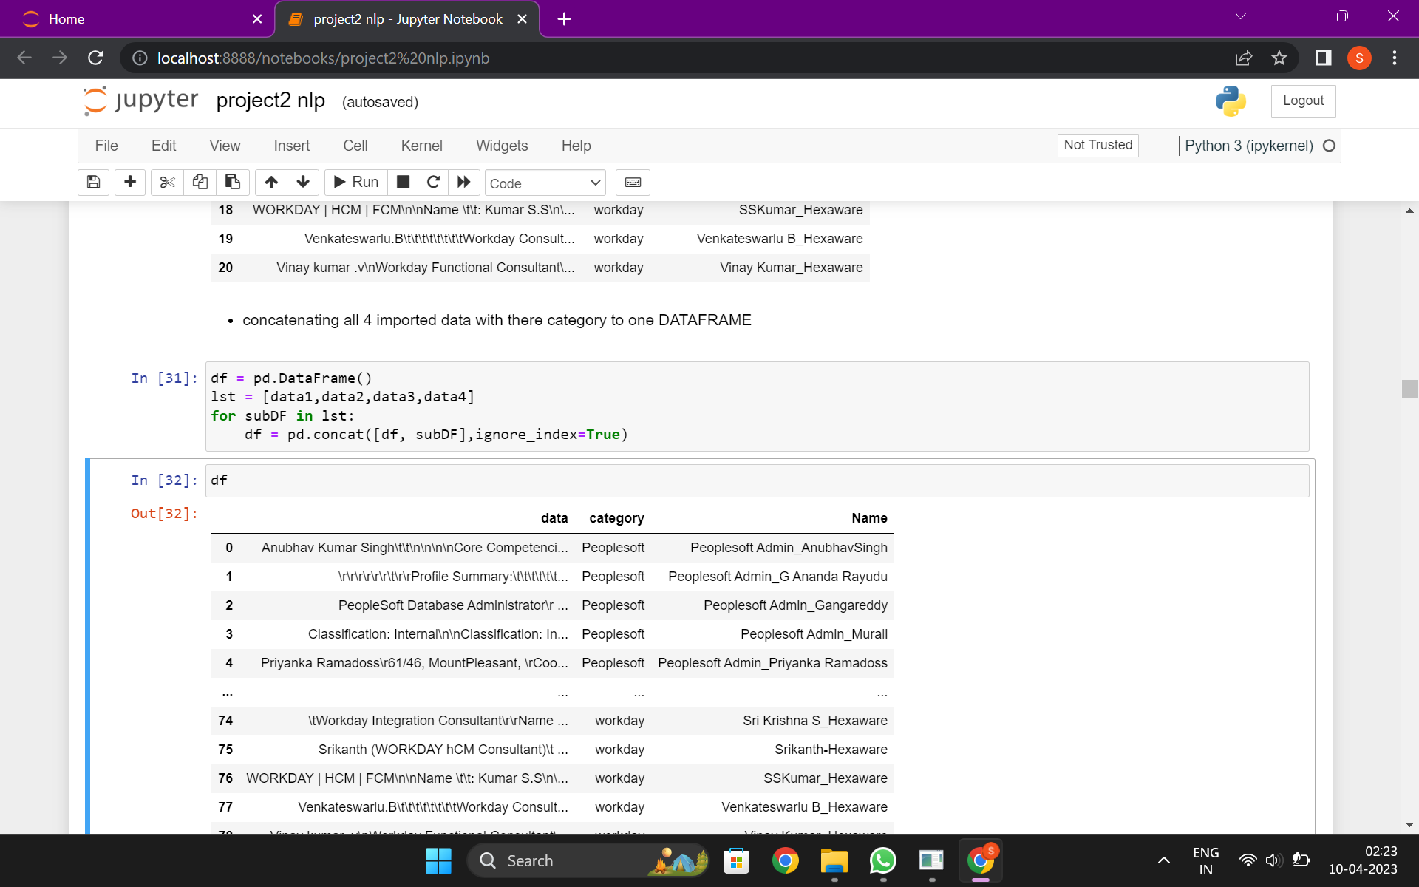
The column ‘Name’ is added and names are being assigned.
All the files are being put into a single data frame.
A new column called skills is created and the skills related data is extracted from each file and put under this column.

Slide 7
EDA
First all the skills are converted into lower case for proper pattern match.
We used isnull() to check for null values.
We checked for duplicate values.
We also performed lemmatization and tokenization.
Other EDA techniques like .dtypes, .describe(), .info() was also used for better understanding of the sample datasets used.

Slide 8
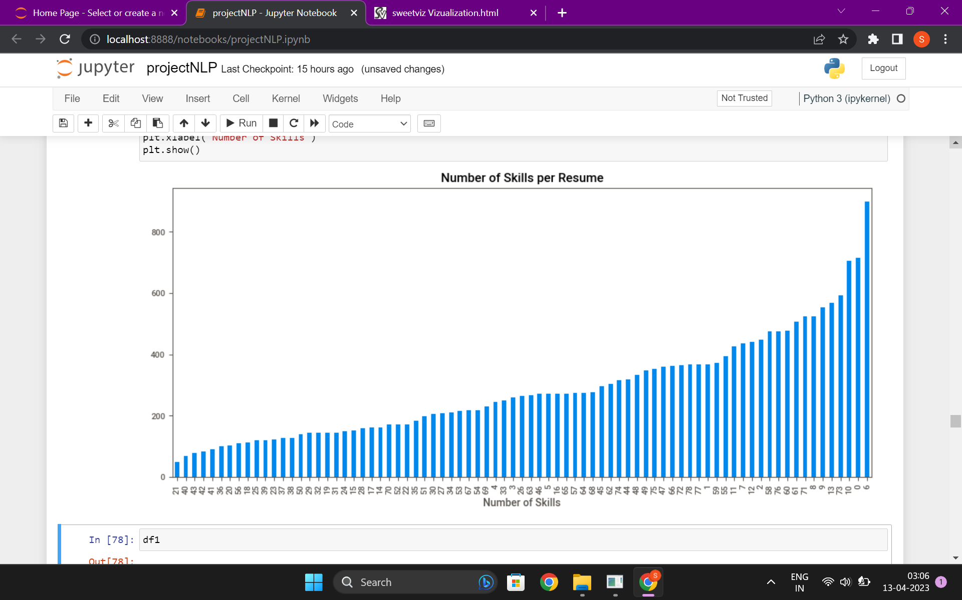
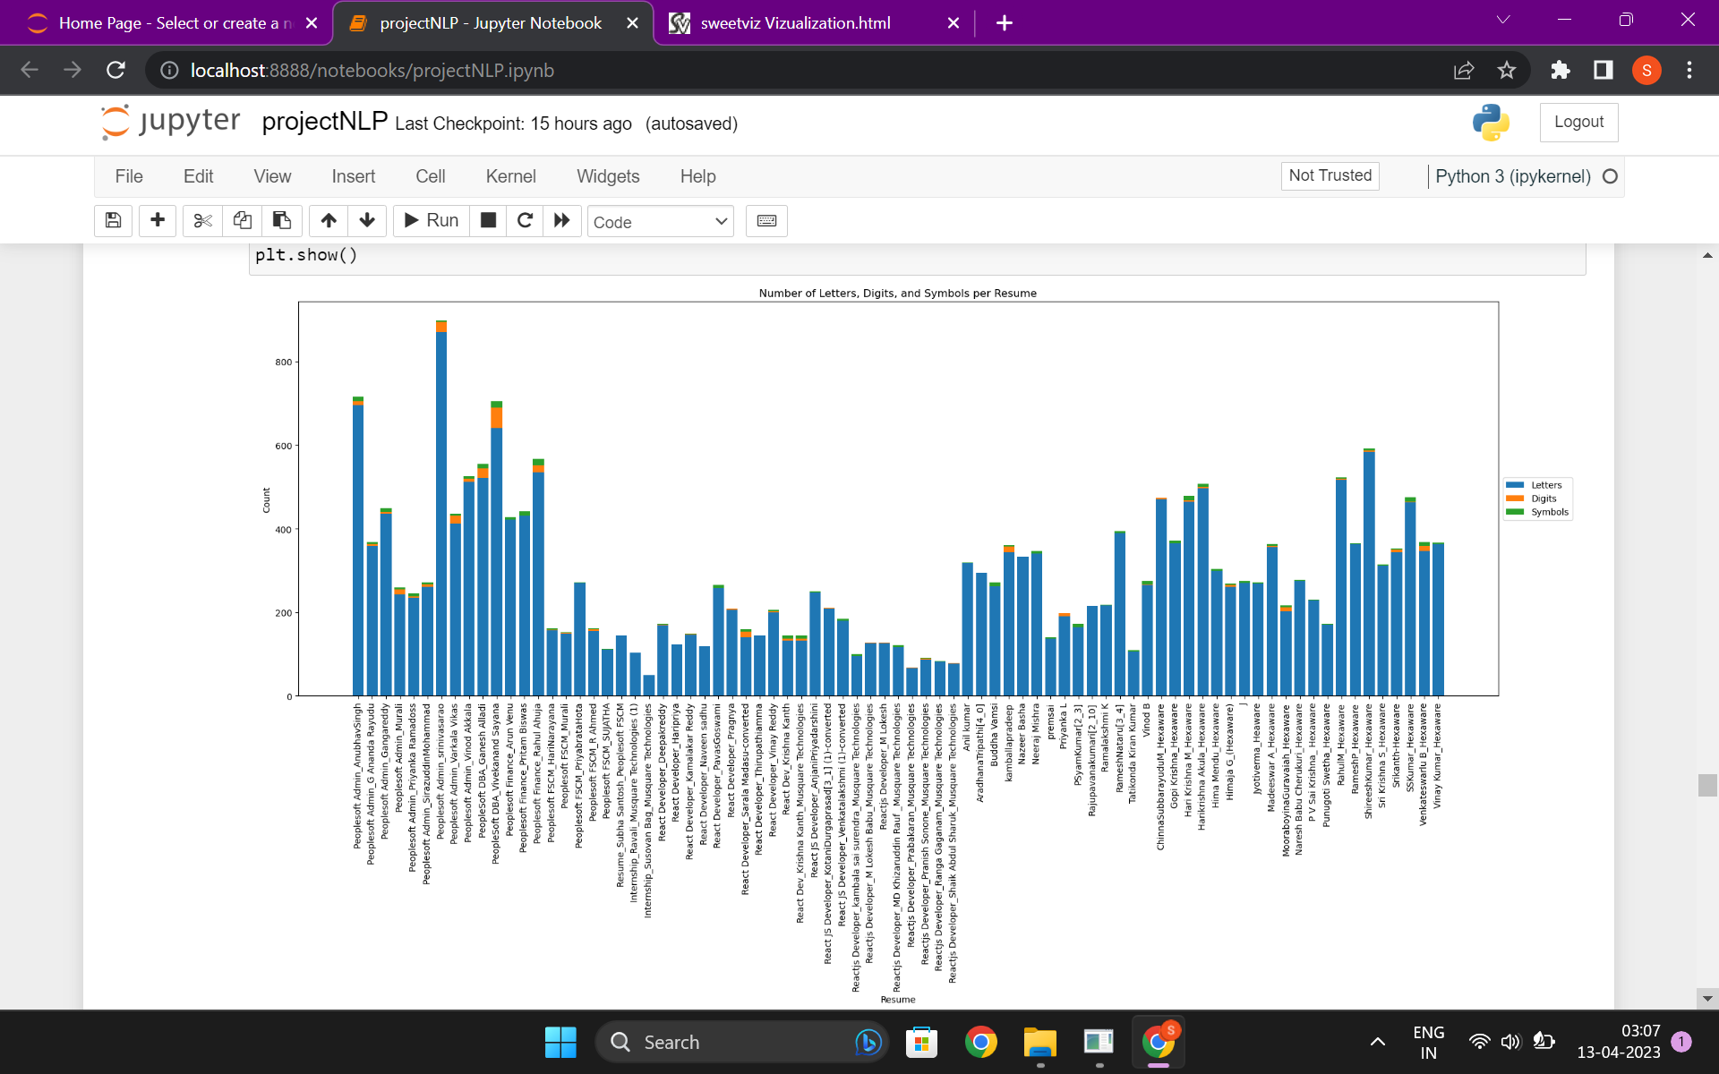
VISUALIZATION
Bar graph used to see the number of skills per resume..
Bar graph used to see the number of letters, digits and symbol per resume..

Slide 9
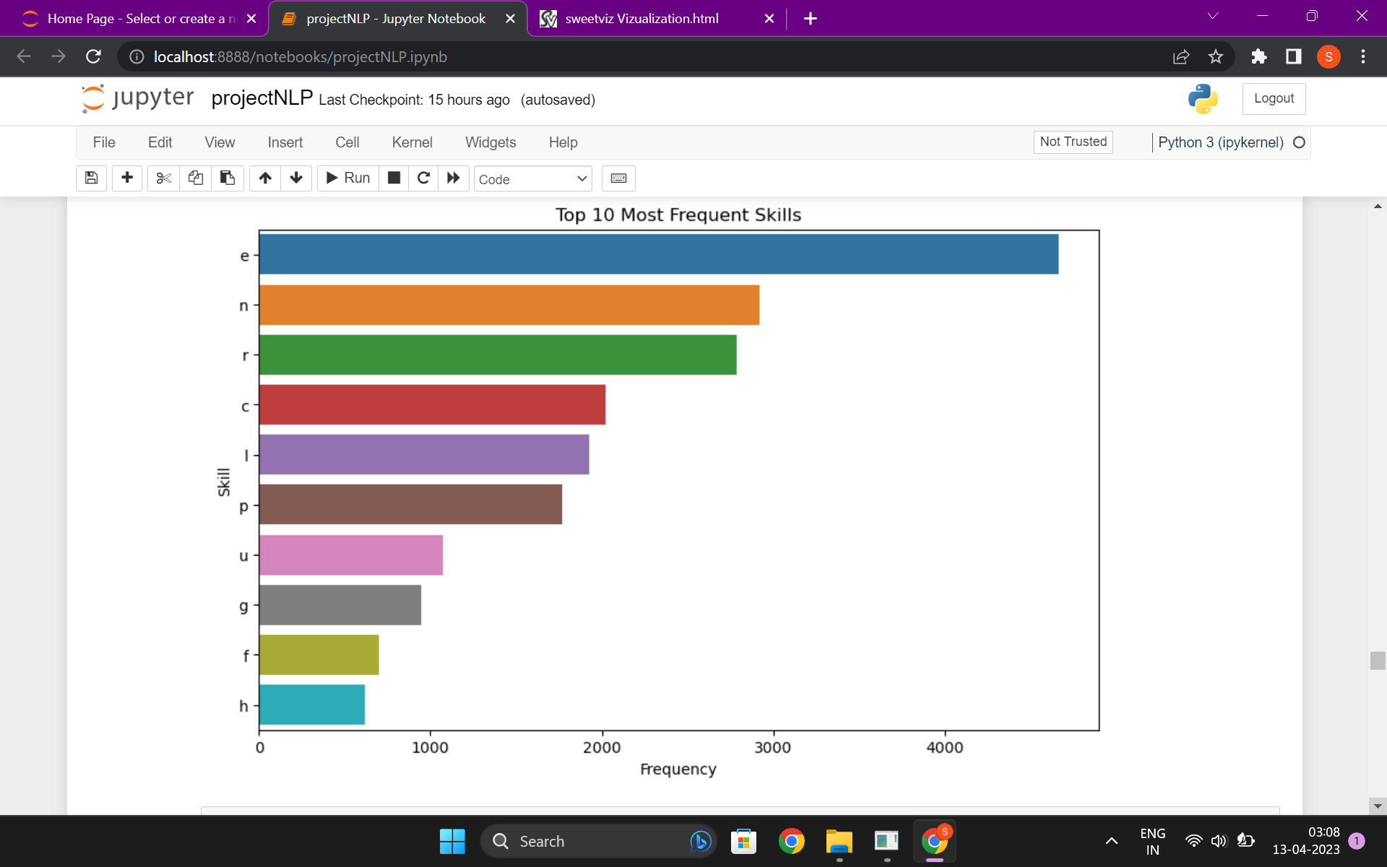
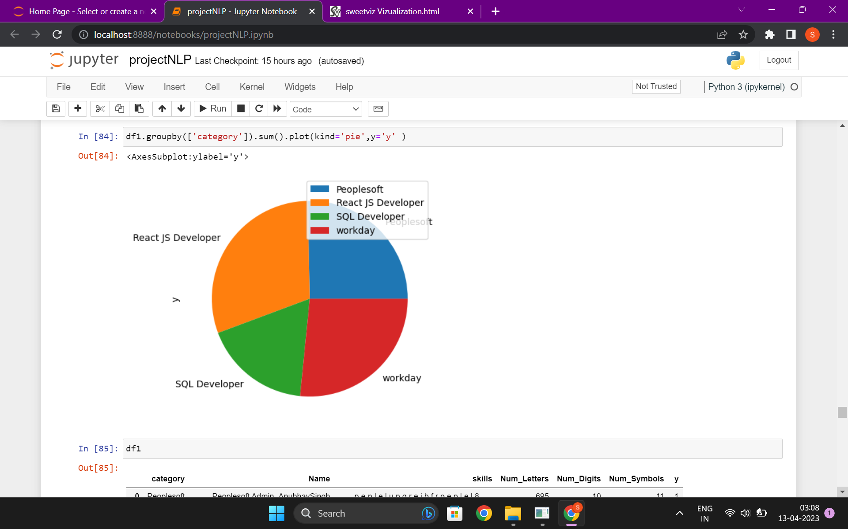
Pie chart used to differentiate categories.
Bar graph used to see top 10 most frequent skills.

Slide 10
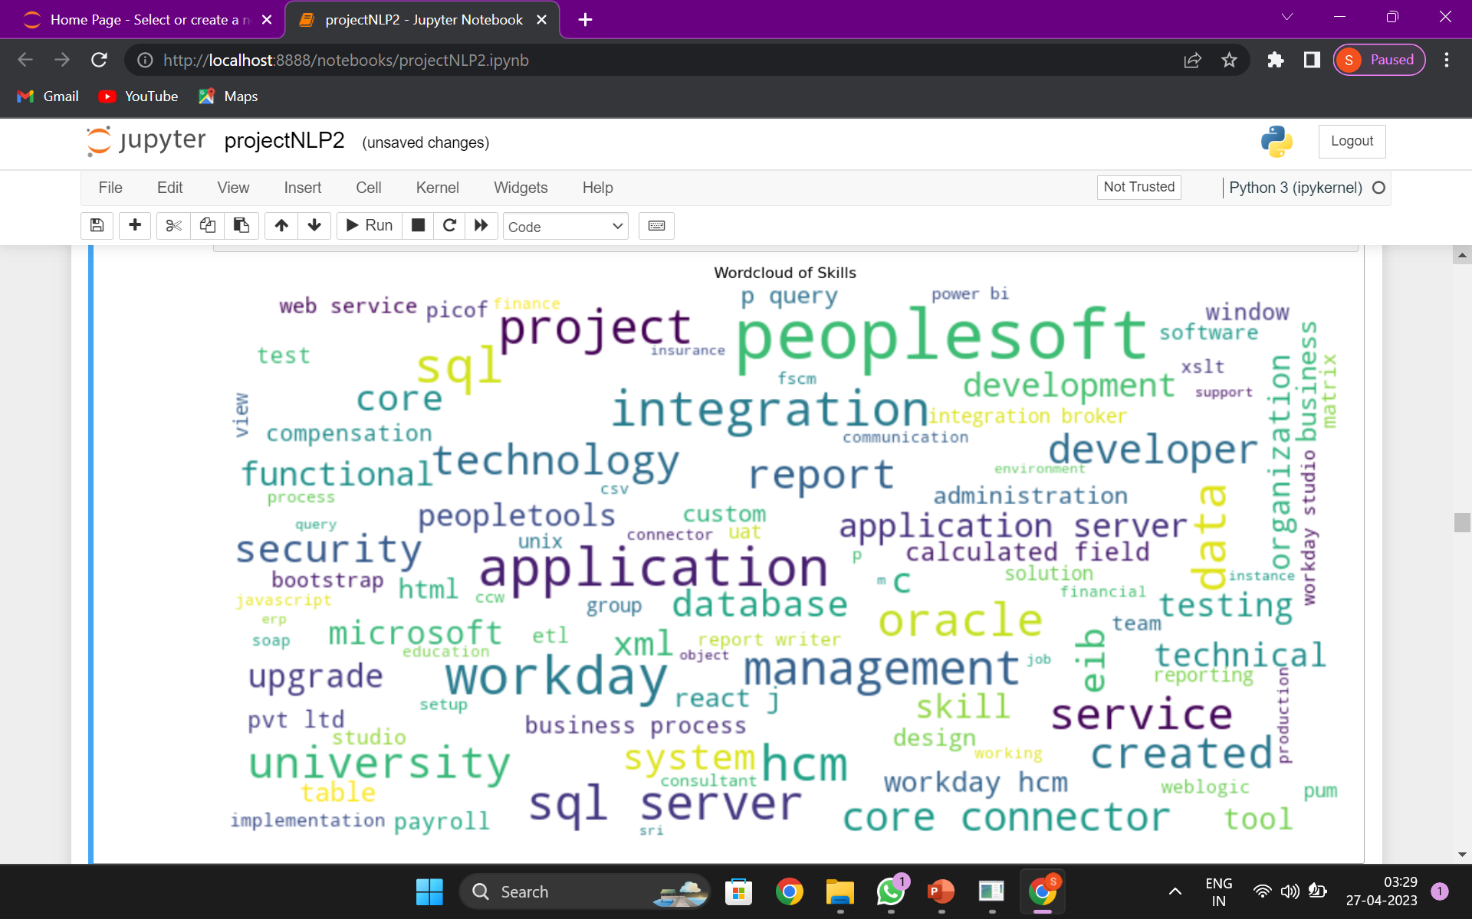
The size of each word in this wordcloud decides the frequencies of each skill.
As per this wordcloud Peoplesoft is repeated most number of times.

Slide 11
Sweet viz was used for effective data analysis. SweetViz.html

Slide 12
MODEL BUILDING AND EVALUATION
Model evaluation is the process of assessing the performance of a machine learning model
that helps to determine the effectiveness and accuracy of a model in making predictions on new data.
The goal of model evaluation is to determine how well a model can generalize to new data and to identify any potential issues or limitations that may impact its performance.

Slide 13
Steps we follow To evaluate the model:
Split the data into training and test sets.
Train the model on the training set using various algorithms such as Logistic Regression, Decision Tree, or Random Forest.
Evaluate the performance of the model on the test set using different evaluation metrics such as accuracy, precision, recall, and F1 score.
Choose the best model based on the evaluation metrics

Slide 14
Algorithms that are used:
from sklearn.naive_bayes import MultinomialNB
from sklearn.neighbors import KNeighborsClassifier
from sklearn.linear_model import LogisticRegression
from sklearn.ensemble import RandomForestClassifier
from sklearn.svm import SVC
from sklearn.ensemble import AdaBoostClassifier
from sklearn.linear_model import SGDClassifier
from sklearn.tree import DecisionTreeClassifier

Slide 15
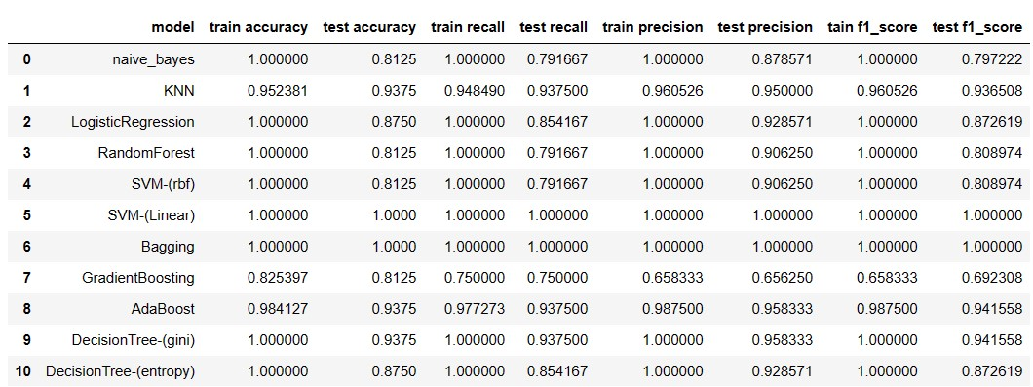
After fitting the different types of Algorithms the results are

Slide 16
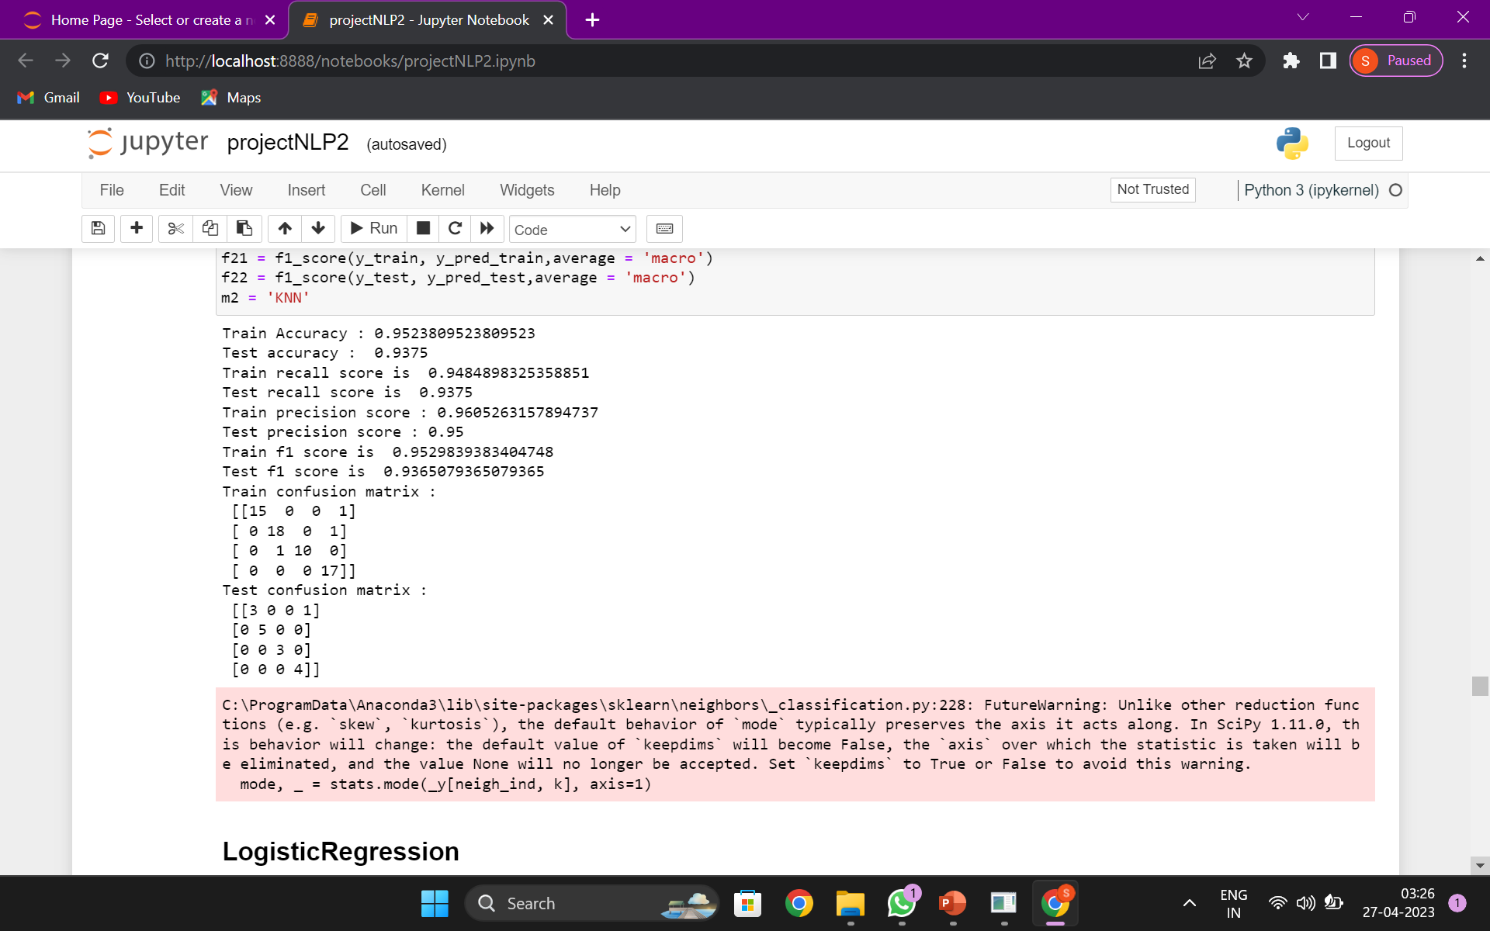
We decided to go with the KNN algorithm which
had 95% accuracy.

Slide 17
DEPLOYMENT
We used streamlit for deployment of the model because
Easy to use: Streamlit is designed to make it easy to build interactive data-driven applications with Python. The syntax is simple and intuitive, and you can get up and running quickly without needing to learn complex web development frameworks.
Rapid development: With Streamlit, you can rapidly prototype and iterate on your ideas. You can see the results of your changes in real-time as you code, which can help you build and refine your application faster. This can be especially helpful if you're working on a project with tight deadlines or need to experiment with different approaches to find the best solution.

Slide 18
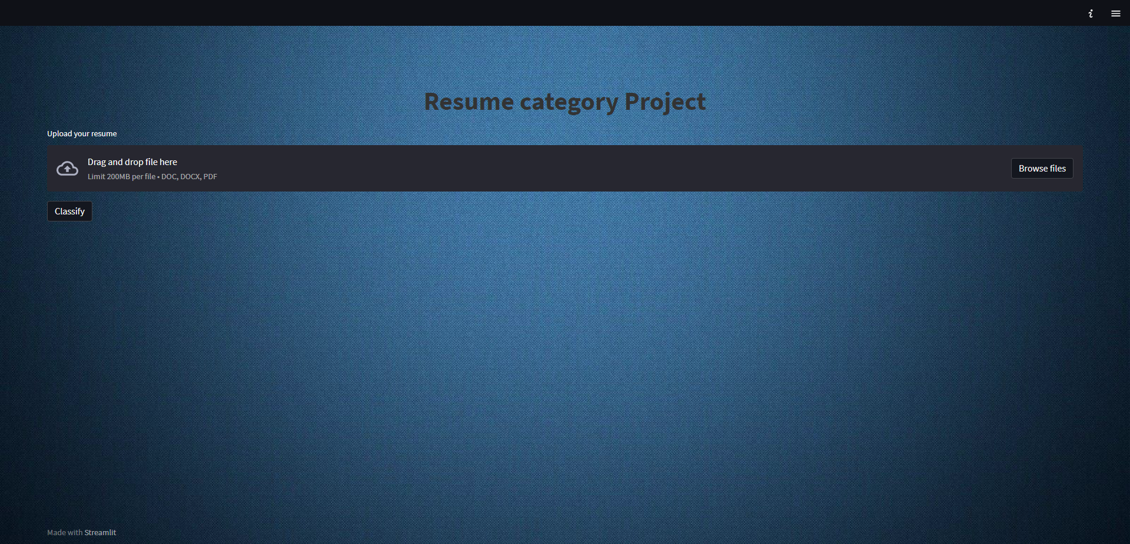
before uploading Resume file

Slide 19
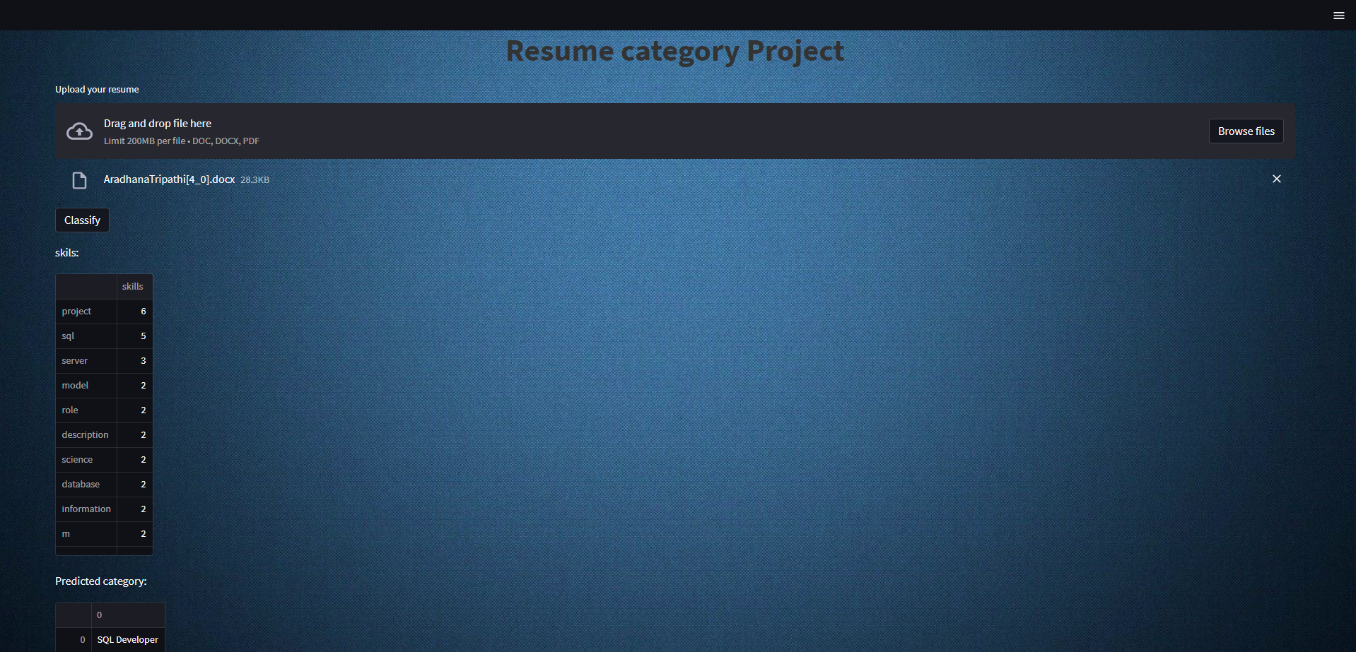
After uploading Resume file

Slide 20
CHALLENGES FACED
1. We were facing issue in extraction of data from the doc format as it was in the openxml format. We used docreader library to fix that issue.
2. After extraction the problem we faced is to segregate the skills from the resume and categorise them. To solve that there we have extrated the data separately and assigned categories accordingly.
3. After that we had used tokenizatiin and lematization to separate the each words and used spacy to remove the stopwords.
4. After this We had created 5+ models. But in that some of them were overfitting and some were not predicting the same ( model not stable) . Therefore, we chose KNN model which was showing stable prediction where the accuracy was 95%.

Slide 21
THANK YOU!

